Slide 1

Introduction to PHP

Slide 2
PHP Introduction
PHP is a recursive acronym for “PHP: Hypertext Preprocessor” -- It is a widely-used open source general-purpose scripting language that is especially suited for web development and can be embedded into HTML.

Slide 3
PHP Introduction
> PHP is a server-side scripting language
> PHP scripts are executed on the server
> PHP supports many databases (MySQL, Informix, Oracle, Sybase, Solid, PostgreSQL, Generic ODBC, etc.)‏
> PHP is open source software

Slide 4
PHP Introduction
> PHP runs on different platforms (Windows, Linux, Unix, etc.)‏
> PHP is compatible with almost all servers used today (Apache, IIS, etc.)‏
> PHP is FREE to download from the official PHP resource: www.php.net
> PHP is easy to learn and runs efficiently on the server side

Slide 5
PHP Introduction
Instead of lots of commands to output HTML (as seen in C or Perl), PHP pages contain HTML with embedded code that does "something" (like in the next slide, it outputs "Hi, I'm a PHP script!").
The PHP code is enclosed in special start and end processing instructions <?php and ?> that allow you to jump into and out of "PHP mode."

Slide 6
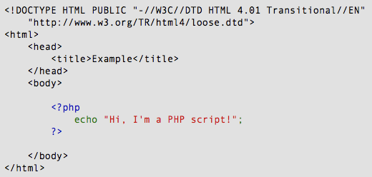
PHP Introduction

Slide 7
PHP Introduction
PHP code is executed on the server, generating HTML which is then sent to the client. The client would receive the results of running that script, but would not know what the underlying code was.
A visual, if you please...

Slide 8
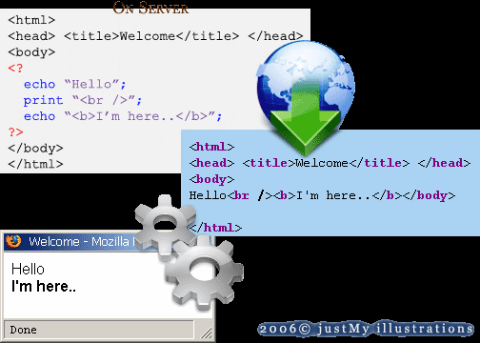
PHP Introduction

Slide 9

PHP Variables
> Variables are used for storing values, like text strings, numbers or arrays.
> When a variable is declared, it can be used over and over again in your script.
> All variables in PHP start with a $ sign symbol.
> The correct way of declaring a variable in PHP:

Slide 10

PHP Variables
> In PHP, a variable does not need to be declared before adding a value to it.
> In the example above, you see that you do not have to tell PHP which data type the variable is.
> PHP automatically converts the variable to the correct data type, depending on its value.

Slide 11
PHP Variables
> A variable name must start with a letter or an underscore "_" -- not a number
> A variable name can only contain alpha-numeric characters, underscores (a-z, A-Z, 0-9, and _ )‏
> A variable name should not contain spaces. If a variable name is more than one word, it should be separated with an underscore ($my_string) or with capitalization ($myString)‏

Slide 12
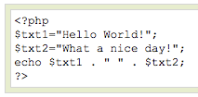
PHP Concatenation
> The concatenation operator (.) is used to put two string values together.
> To concatenate two string variables together, use the concatenation operator:

Slide 13

PHP Concatenation
The output of the code on the last slide will be:
If we look at the code you see that we used the concatenation operator two times. This is because we had to insert a third string (a space character), to separate the two strings.

Slide 14
PHP Operators
Operators are used to operate on values. There are four classifications of operators:
> Arithmetic
> Assignment
> Comparison
> Logical

Slide 15
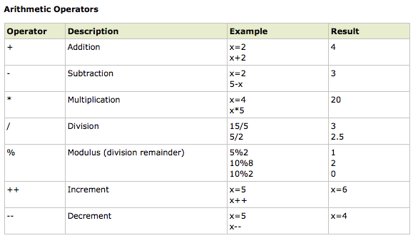
PHP Operators

Slide 16
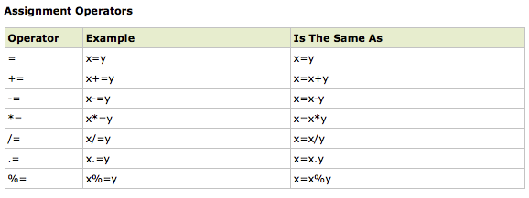
PHP Operators

Slide 17
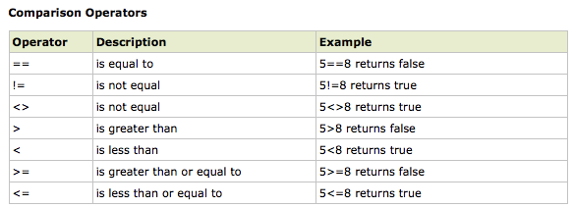
PHP Operators

Slide 18
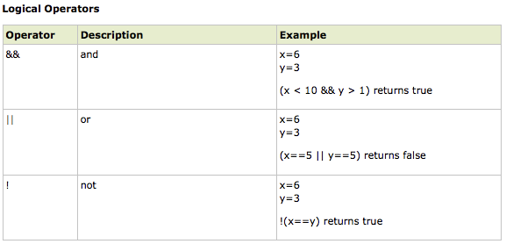
PHP Operators

Slide 19
PHP Conditional Statements
> Very often when you write code, you want to perform different actions for different decisions.
> You can use conditional statements in your code to do this.
> In PHP we have the following conditional statements...

Slide 20
PHP Conditional Statements
> if statement - use this statement to execute some code only if a specified condition is true
> if...else statement - use this statement to execute some code if a condition is true and another code if the condition is false
> if...elseif....else statement - use this statement to select one of several blocks of code to be executed
> switch statement - use this statement to select one of many blocks of code to be executed

Slide 21
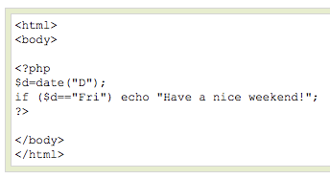
PHP Conditional Statements
The following example will output "Have a nice weekend!" if the current day is Friday:

Slide 22
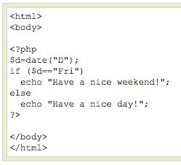
PHP Conditional Statements
Use the if....else statement to execute some code if a condition is true and another code if a condition is false.

Slide 23
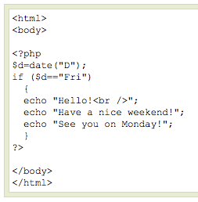
PHP Conditional Statements
If more than one line should be executed if a condition is true/false, the lines should be enclosed within curly braces { }

Slide 24
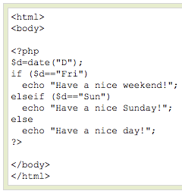
PHP Conditional Statements
The following example will output "Have a nice weekend!" if the current day is Friday, and "Have a nice Sunday!" if the current day is Sunday. Otherwise it will output "Have a nice day!":

Slide 25
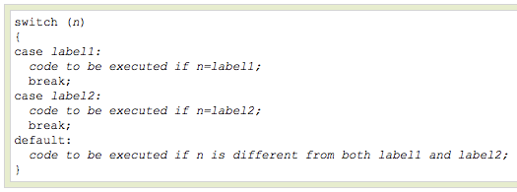
PHP Conditional Statements
Use the switch statement to select one of many blocks of code to be executed.

Slide 26
PHP Conditional Statements
For switches, first we have a single expression n (most often a variable), that is evaluated once.
The value of the expression is then compared with the values for each case in the structure. If there is a match, the block of code associated with that case is executed.
Use break to prevent the code from running into the next case automatically. The default statement is used if no match is found.

Slide 27
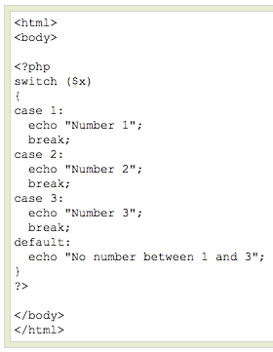
PHP Conditional Statements

Slide 28
PHP Arrays
> An ordinary variable is a storage area holding a number or text. The problem is, a variable will hold only one value.
> An array is a special variable, which can store multiple values in one single variable.

Slide 29

PHP Arrays
If you have a list of items (a list of car names, for example), storing the cars in single variables could look like this:

Slide 30
PHP Arrays
> However, what if you want to loop through the cars and find a specific one? And what if you had not 3 cars, but 300?
> The best solution here is to use an array.
> An array can hold all your variable values under a single name. And you can access the values by referring to the array name.
> Each element in the array has its own index so that it can be easily accessed.

Slide 31
PHP Arrays
In PHP, there are three kind of arrays:
> Numeric array - An array with a numeric index
> Associative array - An array where each ID key is associated with a value
> Multidimensional array - An array containing one or more arrays

Slide 32
PHP Numeric Arrays
> A numeric array stores each array element with a numeric index.
> There are two methods to create a numeric array.

Slide 33
PHP Numeric Arrays
In the following example the index is automatically assigned (the index starts at 0):
In the following example we assign the index manually:

Slide 34
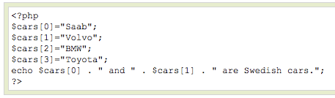

PHP Numeric Arrays
In the following example you access the variable values by referring to the array name and index:
The code above will output:

Slide 35
PHP Associative Arrays
> With an associative array, each ID key is associated with a value.
> When storing data about specific named values, a numerical array is not always the best way to do it.
> With associative arrays we can use the values as keys and assign values to them.

Slide 36

PHP Associative Arrays
In this example we use an array to assign ages to the different persons:
This example is the same as the one above, but shows a different way of creating the array:

Slide 37
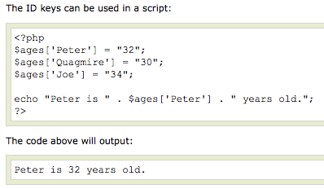
PHP Associative Arrays

Slide 38
PHP Multidimensional Arrays
In a multidimensional array, each element in the main array can also be an array.
And each element in the sub-array can be an array, and so on.

Slide 39
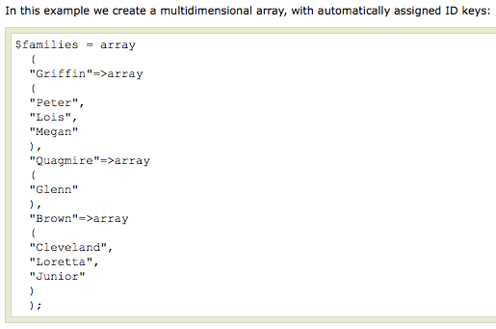
PHP Multidimensional Arrays

Slide 40
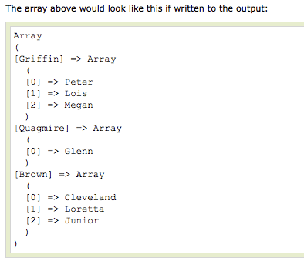
PHP Multidimensional Arrays

Slide 41
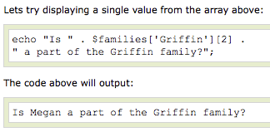
PHP Multidimensional Arrays

Slide 42
PHP Loops
> Often when you write code, you want the same block of code to run over and over again in a row. Instead of adding several almost equal lines in a script we can use loops to perform a task like this.
> In PHP, we have the following looping statements:

Slide 43
PHP Loops
> while - loops through a block of code while a specified condition is true
> do...while - loops through a block of code once, and then repeats the loop as long as a specified condition is true
> for - loops through a block of code a specified number of times
> foreach - loops through a block of code for each element in an array

Slide 44
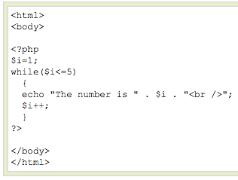
PHP Loops - While
The while loop executes a block of code while a condition is true. The example below defines a loop that starts with
i=1. The loop will
continue to run as
long as i is less
than, or equal to 5.
i will increase by 1
each time the loop
runs:

Slide 45
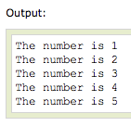
PHP Loops - While

Slide 46
PHP Loops – Do ... While
The do...while statement will always execute the block of code once, it will then check the condition, and repeat the loop while the condition is true.
The next example defines a loop that starts with i=1. It will then increment i with 1, and write some output. Then the condition is checked, and the loop will continue to run as long as i is less than, or equal to 5:

Slide 47
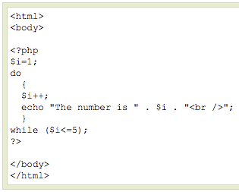
PHP Loops – Do ... While

Slide 48
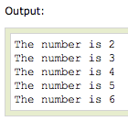
PHP Loops – Do ... While

Slide 49
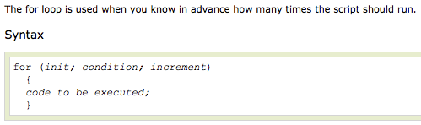
PHP Loops - For

Slide 50
PHP Loops - For
Parameters:
> init: Mostly used to set a counter (but can be any code to be executed once at the beginning of the loop)‏
> condition: Evaluated for each loop iteration. If it evaluates to TRUE, the loop continues. If it evaluates to FALSE, the loop ends.
> increment: Mostly used to increment a counter (but can be any code to be executed at the end of the loop)‏

Slide 51
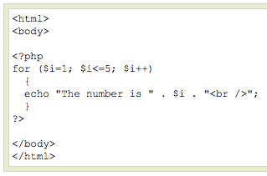
PHP Loops - For
The example below defines a loop that starts with i=1. The loop will continue to run as long as i is less than, or equal to 5. i will increase by 1 each time the loop runs:

Slide 52
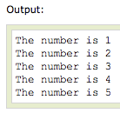
PHP Loops - For

Slide 53

PHP Loops - Foreach
For every loop iteration, the value of the current array element is assigned to $value (and the array pointer is moved by one) - so on the next loop iteration, you'll be looking at the next array value.

Slide 54
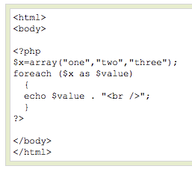
PHP Loops - Foreach
The following example demonstrates a loop that will print the values of the given array:

Slide 55

PHP Loops - Foreach

Slide 56
PHP Functions
> We will now explore how to create your own functions.
> To keep the script from being executed when the page loads, you can put it into a function.
> A function will be executed by a call to the function.
> You may call a function from anywhere within a page.

Slide 57

PHP Functions
A function will be executed by a call to the function.
> Give the function a name that reflects what the function does
> The function name can start with a letter or underscore (not a number)‏

Slide 58
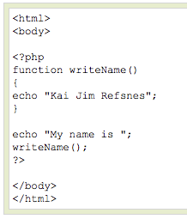
PHP Functions
A simple function that writes a name when it is called:

Slide 59
PHP Functions - Parameters
Adding parameters...
> To add more functionality to a function, we can add parameters. A parameter is just like a variable.
> Parameters are specified after the function name, inside the parentheses.

Slide 60
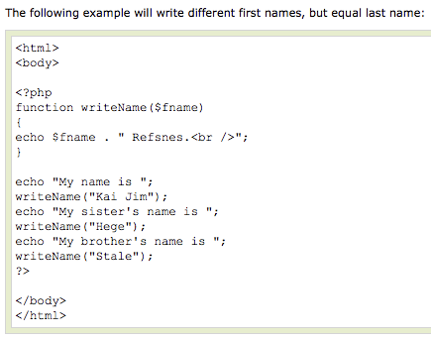
PHP Functions - Parameters

Slide 61

PHP Functions - Parameters

Slide 62
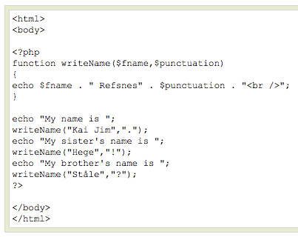
PHP Functions - Parameters
This example adds different punctuation.

Slide 63

PHP Functions - Parameters

Slide 64
PHP Superglobal Variables
Several predefined variables in PHP are "superglobals", which means that they are always accessible, regardless of scope.
$GLOBALS
$_SERVER
$_REQUEST
$_POST
$_GET
$_FILES
$_ENV
$_COOKIE
$_SESSION

Slide 65
PHP Superglobal Variables
PHP $GLOBALS
$GLOBALS is a PHP super global variable which is used to access global variables from anywhere in the PHP script (also from within functions or methods).
PHP stores all global variables in an array called $GLOBALS[index]. The index holds the name of the variable.
<?php
$x = 75;
$y = 25;
function addition() {
$GLOBALS['z'] = $GLOBALS['x'] + $GLOBALS['y'];
}
addition();
echo $z;
?>

Slide 66
PHP Superglobal Variables
PHP $_SERVER
$_SERVER is a PHP super global variable which holds information about headers, paths, and script locations.
Element/Code | Description
$_SERVER['PHP_SELF'] | Returns the filename of the currently executing script
$_SERVER['GATEWAY_INTERFACE'] | Returns the version of the Common Gateway Interface (CGI) the server is using
$_SERVER['SERVER_ADDR'] | Returns the IP address of the host server
$_SERVER['SERVER_NAME'] | Returns the name of the host server (such as www.w3schools.com)
$_SERVER['SERVER_SOFTWARE'] | Returns the server identification string (such as Apache/2.2.24)
$_SERVER['SERVER_PROTOCOL'] | Returns the name and revision of the information protocol (such as HTTP/1.1)
$_SERVER['REQUEST_METHOD'] | Returns the request method used to access the page (such as POST)
$_SERVER['REQUEST_TIME'] | Returns the timestamp of the start of the request (such as 1377687496)
$_SERVER['QUERY_STRING'] | Returns the query string if the page is accessed via a query string
$_SERVER['HTTP_ACCEPT'] | Returns the Accept header from the current request

Slide 67
PHP Superglobal Variables
Element/Code | Description
$_SERVER['HTTP_ACCEPT_CHARSET'] | Returns the Accept_Charset header from the current request (such as utf-8,ISO-8859-1)
$_SERVER['HTTP_HOST'] | Returns the Host header from the current request
$_SERVER['HTTP_REFERER'] | Returns the complete URL of the current page (not reliable because not all user-agents support it)
$_SERVER['HTTPS'] | Is the script queried through a secure HTTP protocol
$_SERVER['REMOTE_ADDR'] | Returns the IP address from where the user is viewing the current page
$_SERVER['REMOTE_HOST'] | Returns the Host name from where the user is viewing the current page
$_SERVER['REMOTE_PORT'] | Returns the port being used on the user's machine to communicate with the web server
$_SERVER['SCRIPT_FILENAME'] | Returns the absolute pathname of the currently executing script
$_SERVER['SERVER_ADMIN'] | Returns the value given to the SERVER_ADMIN directive in the web server configuration file (if your script runs on a virtual host, it will be the value defined for that virtual host) (such as someone@w3schools.com)
$_SERVER['SERVER_PORT'] | Returns the port on the server machine being used by the web server for communication (such as 80)
$_SERVER['SERVER_SIGNATURE'] | Returns the server version and virtual host name which are added to server-generated pages
$_SERVER['PATH_TRANSLATED'] | Returns the file system based path to the current script
$_SERVER['SCRIPT_NAME'] | Returns the path of the current script
$_SERVER['SCRIPT_URI'] | Returns the URI of the current page

Slide 68
PHP Superglobal Variables
PHP $_REQUEST
PHP $_REQUEST is used to collect data after submitting an HTML form.
<html>
<body>
<form method="post" action="<?php echo $_SERVER['PHP_SELF'];?>">
Name: <input type="text" name="fname">
<input type="submit">
</form>
<?php
if ($_SERVER["REQUEST_METHOD"] == "POST") {
// collect value of input field
$name = $_REQUEST['fname'];
if (empty($name)) {
echo "Name is empty";
} else {
echo $name;
}
}
?>
</body>
</html>

Slide 69
PHP Forms - $_GET Function
> The built-in $_GET function is used to collect values from a form sent with method="get".
> Information sent from a form with the GET method is visible to everyone (it will be displayed in the browser's address bar) and has limits on the amount of information to send (max. 100 characters).

Slide 70
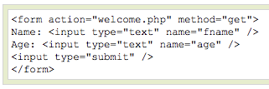


PHP Forms - $_GET Function
Notice how the URL carries the information after the file name.

Slide 71
PHP Forms - $_GET Function
The "welcome.php" file can now use the $_GET function to collect form data (the names of the form fields will automatically be the keys in the $_GET array)‏

Slide 72
PHP Forms - $_GET Function
> When using method="get" in HTML forms, all variable names and values are displayed in the URL.
> This method should not be used when sending passwords or other sensitive information!
> However, because the variables are displayed in the URL, it is possible to bookmark the page. This can be useful in some cases.
> The get method is not suitable for large variable values; the value cannot exceed 100 chars.

Slide 73
PHP Forms - $_POST Function
> The built-in $_POST function is used to collect values from a form sent with method="post".
> Information sent from a form with the POST method is invisible to others and has no limits on the amount of information to send.
> Note: However, there is an 8 Mb max size for the POST method, by default (can be changed by setting the post_max_size in the php.ini file).

Slide 74


PHP Forms - $_POST Function
And here is what the code of action.php might look like:

Slide 75
PHP Forms - $_POST Function
When to use method="post"?
> Information sent from a form with the POST method is invisible to others and has no limits on the amount of information to send.
> However, because the variables are not displayed in the URL, it is not possible to bookmark the page.

Slide 76
Sorting Arrays
sort() - sort arrays in ascending order
rsort() - sort arrays in descending order
asort() - sort associative arrays in ascending order, according to the value
ksort() - sort associative arrays in ascending order, according to the key
arsort() - sort associative arrays in descending order, according to the value
krsort() - sort associative arrays in descending order, according to the key

Slide 77
Different Printing Methods
Difference between echo and print
echo - can output one or more strings
print - can only output one string, and returns always 1
echo is faster than print as echo does not return any value.

Slide 78
PHP include and require Statements
It is possible to insert the content of one PHP file into another PHP file (before the server executes it), with the include or require statement.
The include and require statements are identical, except upon failure:
require will produce a fatal error (E_COMPILE_ERROR) and stop the script
include will only produce a warning (E_WARNING) and the script will continue

Slide 79
PHP include and require Statements
<html>
<body>
<h1>Welcome to my home page!</h1>
<?php include 'noFileExists.php';
echo "I have a $color $car.";
?>
</body>
</html>
<html>
<body>
<h1>Welcome to my home page!</h1>
<?php require 'noFileExists.php';
echo "I have a $color $car.";
?>
</body>
</html>
when a file is included with the include statement and PHP cannot find it, the script will continue to execute
If we do the same example using the require statement, the echo statement will not be executed because the script execution dies after the require statement returned a fatal error

Slide 80
Include, include_once, require, require_once
Include
The include() statement includes and evaluates the specified file.
Include Once
The include_once() statement includes and evaluates the specified file during the execution of the script. This is a behavior similar to the include() statement, with the only difference being that if the code from a file has already been included, it will not be included again. As the name suggests, it will be included just once.
Require
require() and include() are identical in every way except how they handle failure. They both produce a Warning, but require() results in a Fatal Error. In other words, don’t hesitate to use require() if you want a missing file to halt processing of the page.
Require Once
The require_once() statement includes and evaluates the specified file during the execution of the script. This is a behavior similar to the require() statement, with the only difference being that if the code from a file has already been included, it will not be included again.

Slide 81
File Open/Read/Close
PHP Open File - fopen()
The fopen() function opens a file. The first parameter of fopen() contains the name of the file to be opened and the second parameter specifies in which mode the file should be opened.
Modes | Description
r | Open a file for read only. File pointer starts at the beginning of the file
w | Open a file for write only. Erases the contents of the file or creates a new file if it doesn't exist. File pointer starts at the beginning of the file
a | Open a file for write only. The existing data in file is preserved. File pointer starts at the end of the file. Creates a new file if the file doesn't exist
x | Creates a new file for write only. Returns FALSE and an error if file already exists
r+ | Open a file for read/write. File pointer starts at the beginning of the file
w+ | Open a file for read/write. Erases the contents of the file or creates a new file if it doesn't exist. File pointer starts at the beginning of the file
a+ | Open a file for read/write. The existing data in file is preserved. File pointer starts at the end of the file. Creates a new file if the file doesn't exist
x+ | Creates a new file for read/write. Returns FALSE and an error if file already exists

Slide 82
File Open/Read/Close
PHP Read File - fread()
The fread() function reads from an open file.
The first parameter of fread() contains the name of the file to read from and the second parameter specifies the maximum number of bytes to read.
fread($myfile,filesize("webdictionary.txt"));
PHP Close File - fclose()
The fclose() function is used to close an open file. The fclose() requires the name of the file that will be closed.
<?php
$myfile = fopen("webdictionary.txt", "r");
// some code to be executed....
fclose($myfile);
?>

Slide 83
File Upload
Make sure that file_uploads = On in php.ini file
Make sure that the form uses method="post"
The form also needs the following attribute: enctype="multipart/form-data". It specifies which content-type to use when submitting the form
$target_dir - specifies the directory where the file is going to be placed
$target_file - specifies the path of the file to be uploaded
$imageFileType - holds the file extension of the file

Slide 84
File Upload
<?php
$target_dir = "uploads/";
$target_file = $target_dir . basename($_FILES["fileToUpload"]["name"]);
$uploadOk = 1;
$imageFileType = pathinfo($target_file,PATHINFO_EXTENSION);
// Check if image file is a actual image or fake image
if(isset($_POST["submit"])) {
$check = getimagesize($_FILES["fileToUpload"]["tmp_name"]);
if($check !== false) {
echo "File is an image - " . $check["mime"] . ".";
$uploadOk = 1;
} else {
echo "File is not an image.";
$uploadOk = 0;
}
}
// Check if file already exists
if (file_exists($target_file)) {
echo "Sorry, file already exists.";
$uploadOk = 0;
}

Slide 85
// Check file size
if ($_FILES["fileToUpload"]["size"] > 500000) {
echo "Sorry, your file is too large.";
$uploadOk = 0;
}
// Allow certain file formats
if($imageFileType != "jpg" && $imageFileType != "png" && $imageFileType != "jpeg"
&& $imageFileType != "gif" ) {
echo "Sorry, only JPG, JPEG, PNG & GIF files are allowed.";
$uploadOk = 0;
}
// Check if $uploadOk is set to 0 by an error
if ($uploadOk == 0) {
echo "Sorry, your file was not uploaded.";
// if everything is ok, try to upload file
} else {
if (move_uploaded_file($_FILES["fileToUpload"]["tmp_name"], $target_file)) {
echo "The file ". basename( $_FILES["fileToUpload"]["name"]). " has been uploaded.";
} else {
echo "Sorry, there was an error uploading your file.";
}
}
?>

